Slide 1
Chapter 4
Data Type, Operator &
Control Statement

Slide 2
Topics
04 - 2
Basic Data Type
Operator
Control Statement
Try, catch, Finally
NSArray, NSMutableArray
NSDictionary

Slide 3
Basic Data Type
04 - 3
Type | Meaning
int | integer value : that is , a value that contains no decimal point; guaranteed to contain at least 32 bits of accuracy
float | Floating-point value; that is , a value that can contain decimal places; guaranteed to contain as least six digits of precision
double | Extended accuracy floating-point value; guaranteed to contain at least 10 digits of precision
char | Single character value

Slide 4
Type id
04 - 4
The id data type is used to store an object of any type. In a sense , it is a generic object type (or weak type).
Example:
id number;
-(id) newObject : (int) type

Slide 5
Some of Operator(1)
04 - 5
Operator | Description
* | Multiplication
/ | Division
% | Modulo ( 5 % 3 = 2)
<= | Less than or equal
>= | Greater than or equal
&& | Logical AND
|| | Logical OR
+= | Assignment + (a = a + b, a +=b)
-= | Assignment - (a = a - b, a -=b)
/= | Assignment / ( a = a/b, a /=b)
!= | Inequality
== | Logical comparison

Slide 6
The if statement
04 - 6
Syntax:
if (expression)
program statement;
Example :
if (n < 0) {
m += 2;
NSLog(@” n is negative number”); }

Slide 7
The if-else statement
04 - 7
Syntax:
if (expression)
program statement;
else
program statement;
Example :
if (n < 0)
m += 1;
else
p += 1;

Slide 8
The switch statement
04 - 8
Syntax :
switch (expression) {
case value1:
program statement;
break;
case value2:
program statement;
break;
default;
program statement;
break;
}

Slide 9
The for statement
04 - 9
Syntax :
for (init-expression; loop_condition ; loop_expression)
program statement;
Example :
for (int i = 1; i <=10 ; i++) x +=1;

Slide 10
The for-each statement
04 - 10
Syntax :
for (<each-type> <instance> in <collection> )
program statement;
Example :
for (NSString * s in myArray)
NSLog(@”%@”, s);

Slide 11
The while statement
04 - 11
Syntax:
while (expression)
program statement;
Example :
while ( x < 5 ) {
NSLog(@”I am in loop”);
x +=1;
}

Slide 12
The do statement
04 - 12
Syntax:
do
program statement;
while (expression);
Example :
do {
NSLog(@”I am in loop”);
x += 1;
} while (x < 5);

Slide 13
Try-catch-finally
04 - 13
Syntax:
@try {
program statement;
}
@catch (NSException *ex) {
program statement;
}
@finally {
program statement;
}

Slide 14
Basic Array
04 - 14
int x[10], i;
for (i = 0 ; i< 10 ; i++)
x[i] = i;
for (i = 9 ; i >=0 ; i--)
NSLog(@" %d", x[i]);

Slide 15
Character Arrays
04 - 15
char word[] = {'H','e','l','l','o'};
int i;
for (i=0; i < 6 ; ++i)
NSLog(@"%c", word[i]);
}

Slide 16
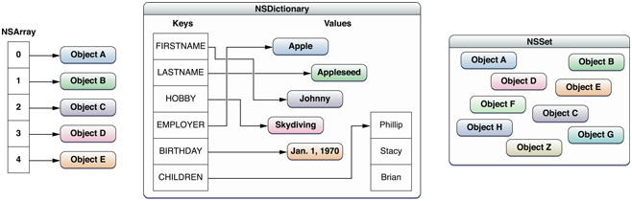
Collections
04 - 16

Slide 17
NSArray
04 - 17
An NSArray object manages an immutable array. After you have create the array, you cannot add, remove, or replace objects.
You can, however, modify individual elements themselves (if they support modification)
Example
NSArray *array;
array = [NSArray arrayWithObjects:@"One", @"Two", @"Three", nil];
for (int i = 0 ; i < [array count] ; i++)
NSLog(@"index %d has %@", i, [array objectAtIndex:i]);

Slide 18
NSMutableArray
04 - 18
An NSMutableArray object manages a mutable array, which allows the addition and deletion of entries at any time, automatically allocating memory as needed.
NSMutableArray *items = [[NSMutableArray alloc] init];
[items addObject:@"One"];
[items addObject:@"Two"];
[items addObject:@"Three"];
[items insertObject:@"Zero" atIndex:0];
for (int i = 0; i < [items count]; i++)
NSLog(@"%@", [items objectAtIndex:i]);

Slide 19
Copy NSArray to NSMutableArray
04 - 19
NSArray * myArray = [NSArray arrayWithObjects:@"One",
@"Two",
@"Three",
nil];
NSMutableArray *myMutableArray = [myArray mutableCopy];
for (NSString *s in myMutableArray)
NSLog(@"%@", s);

Slide 20
NSArray Modern Syntax
04 - 20
Xcode 5 (iOS 7 / OS X 10.9 SDK) only
Convert exist code from menu “Edit > Refactor > Convert to Modern Objective-C Syntax”
Traditional Syntax
NSArray * array = [NSArray arrayWithObjects: @"one", @"two", nil]; [array replaceObjectIndex:0 withObject:””];
Modern Syntax
NSArrar * array = @[@“one”, @“two”]; array[0] = @””;

Slide 21
Most used NSMutableArray methods
04 - 21
addObject:
insertObject: atIndex:
removeLastObject
removeObjectAtIndex:
replaceObjectAtIndex: withObject:

Slide 22
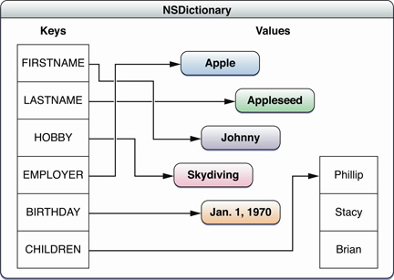
NSDictionary
04 - 22
Dictionaries manage pairs of keys and values.
A key-value pair within a dictionary is called an entry. Each entry consists of one object that represents the key, and a second object which is that key’s value.
Within a dictionary, the keys are unique.
A key can be any object that adopts the NSCopying protocol and implements the hash and isEqual: methods.

Slide 23
NSDictionary
04 - 23
NSDictionary *myDictionary = [NSDictionary dictionaryWithObjectsAndKeys:
@"Harry Potter", @"2",
@"Ron Wisley", @"1",
@"Tom Riddle", @"3",
@"Voldermort", @"0",
nil ];
for (int i = 0; i < 4; i++)
NSLog(@"%@", [myDictionary objectForKey:
[NSString stringWithFormat:@"%i", i]]);

Slide 24
NSMutableDictionary
04 - 24
NSMutableDictionary object manages a mutable dictionary, which allows the addition and deletion of entries at any time, automatically allocating memory as needed.
You should use a mutable dictionary if the dictionary changes incrementally, or is very large—as large collections take more time to initialize.
Most used methods
dictionaryWithObjectsAndKeys:
removeObjectForKey:
setObject: forKey:
removeObjectForKey:

Slide 25
NSDictionary Modern Syntax
Traditional Syntax
NSDictionary * dictionary = [NSDictionary dictionaryWithObjectsAndKey: @“one”, @”1”, @“two”, @”2”, nil];
Modern Syntax
NSDictionary * dictionary = @{ @”1”: @”one”, @”2”: @”two” };

Slide 26
NSDictionary Modern Syntax
Traditional Syntax
NSString * tmp = [dictionary objectForKey:1]; [dictionary setObject:@”” forKey:@”1”];
Modern Syntax
NSString * tmp = dictionary[@1]; dictionary[@”1”] = @””;

